Slide 1
Little Miss Muffet
By

Slide 2
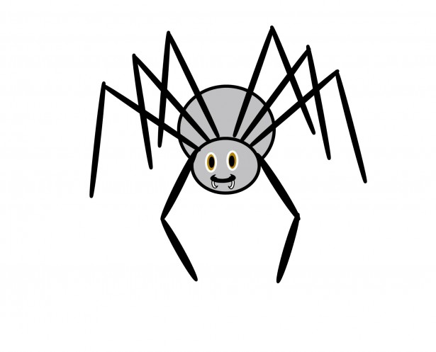
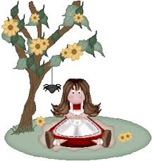
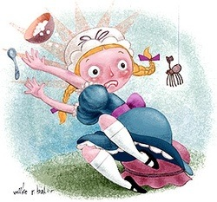
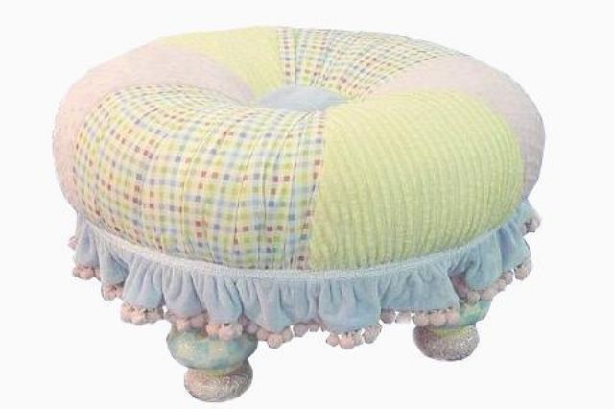
Using the pictures below, arrange the following according to the rhyme.
Pictures

Slide 3
Little Miss Muffet

Slide 4
Sat on a tuffet,

Slide 5
Eating her curds and whey,

Slide 6
Along came a spider,

Slide 7
Who sat down beside her,

Slide 8
And frightened Miss Muffet away.

Slide 9
Fill up the following rhyme with the following words. Diamond – wonder – little star - high
Twinkle twinkle **,
How I ** how you are,
Up above the world so **,
Like a ** in the sky.

